Slide 1
Finding Pet Plus++ Product Owner: Runhan Xu
Tech Leader: Yunbai Zhang

Slide 2
Contents
Product Part
1. Preface
2. Product Design
3. Business Analysis
Tech Part
1. Product Building
2. Face Verification
3. Face Recognition
4. User Experience Enhancement

Slide 3
Product Part

Slide 4
1. Preface

Slide 5
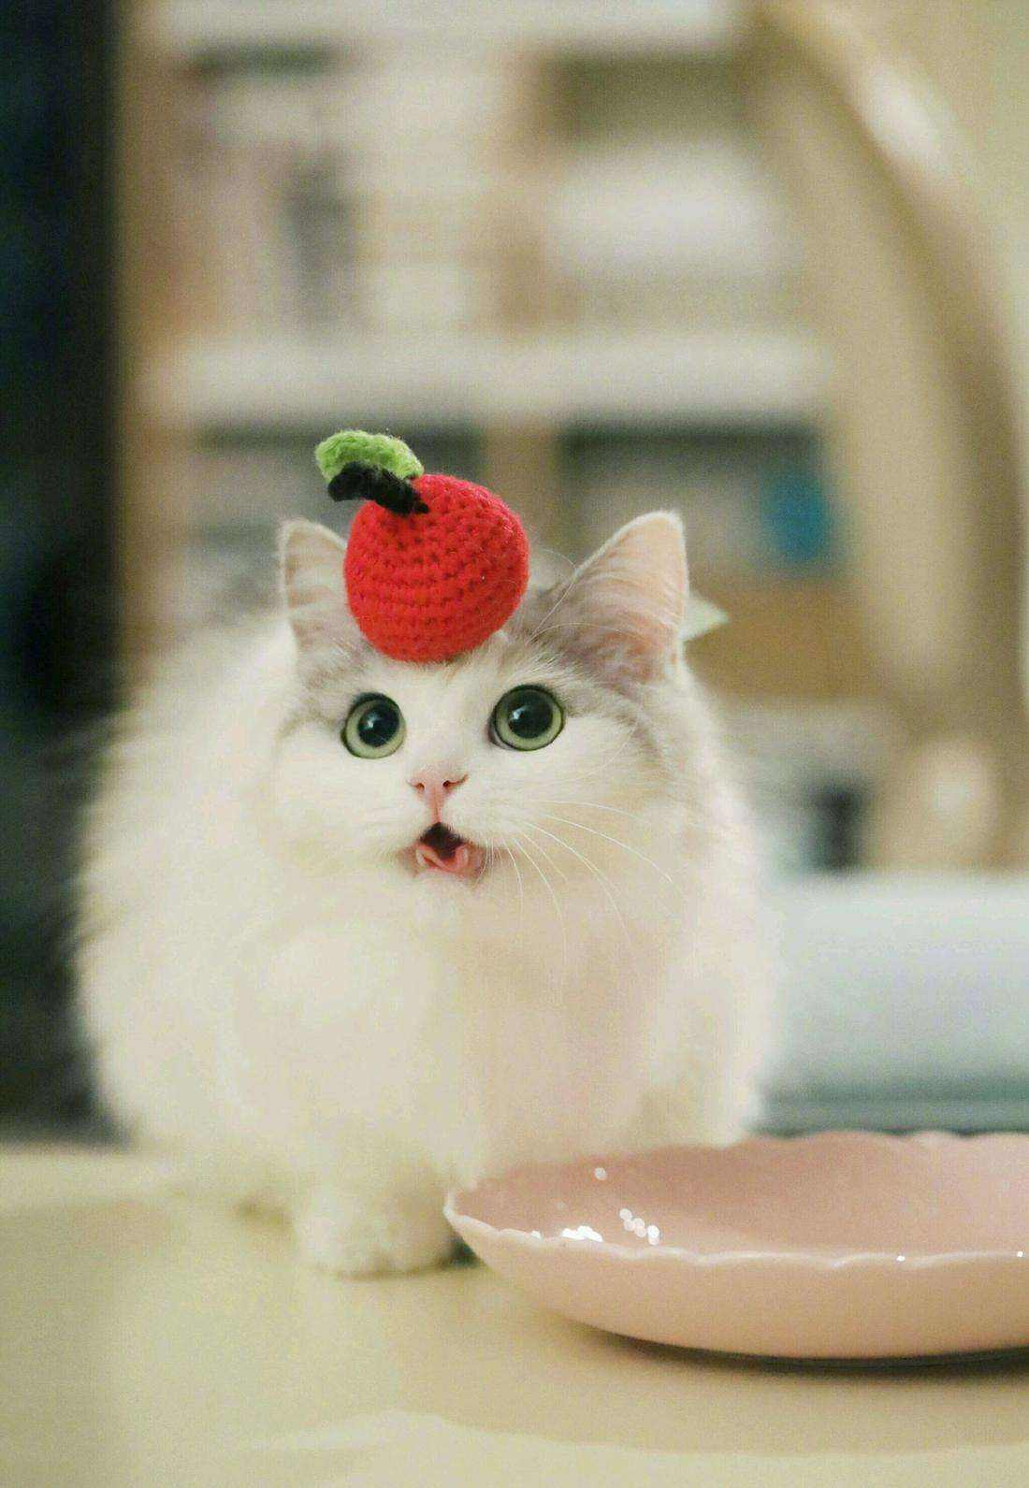
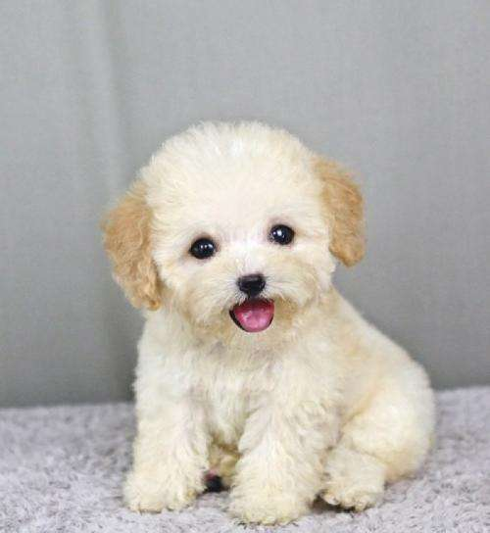
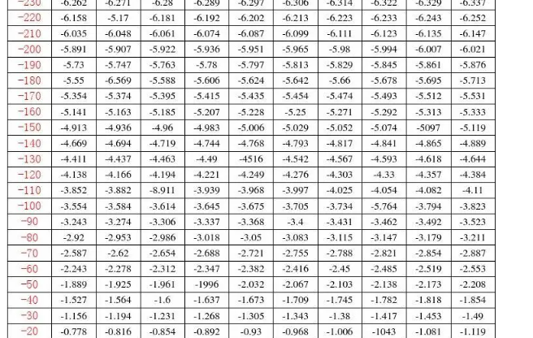
Beginning

Slide 6
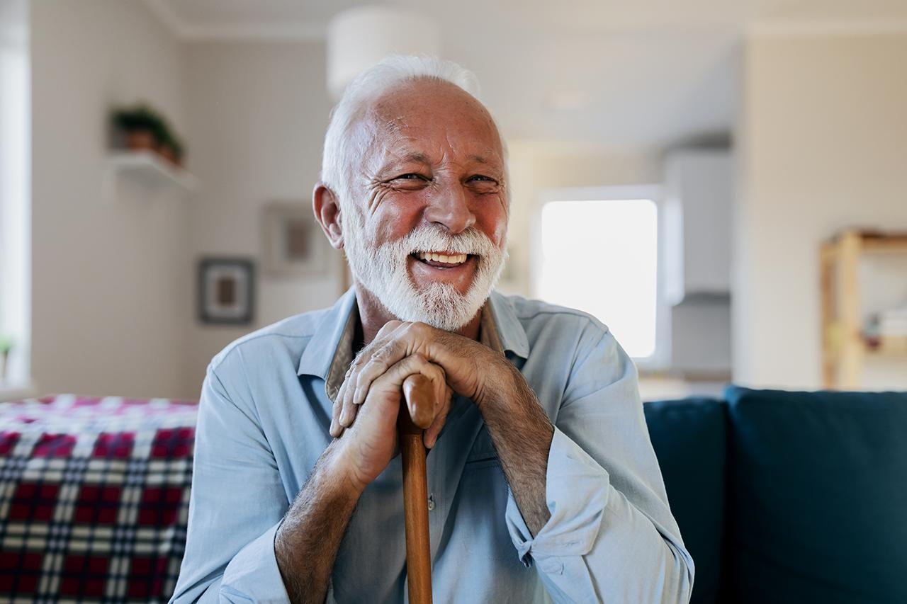
2. Idea
Our Product
Lost

Slide 7
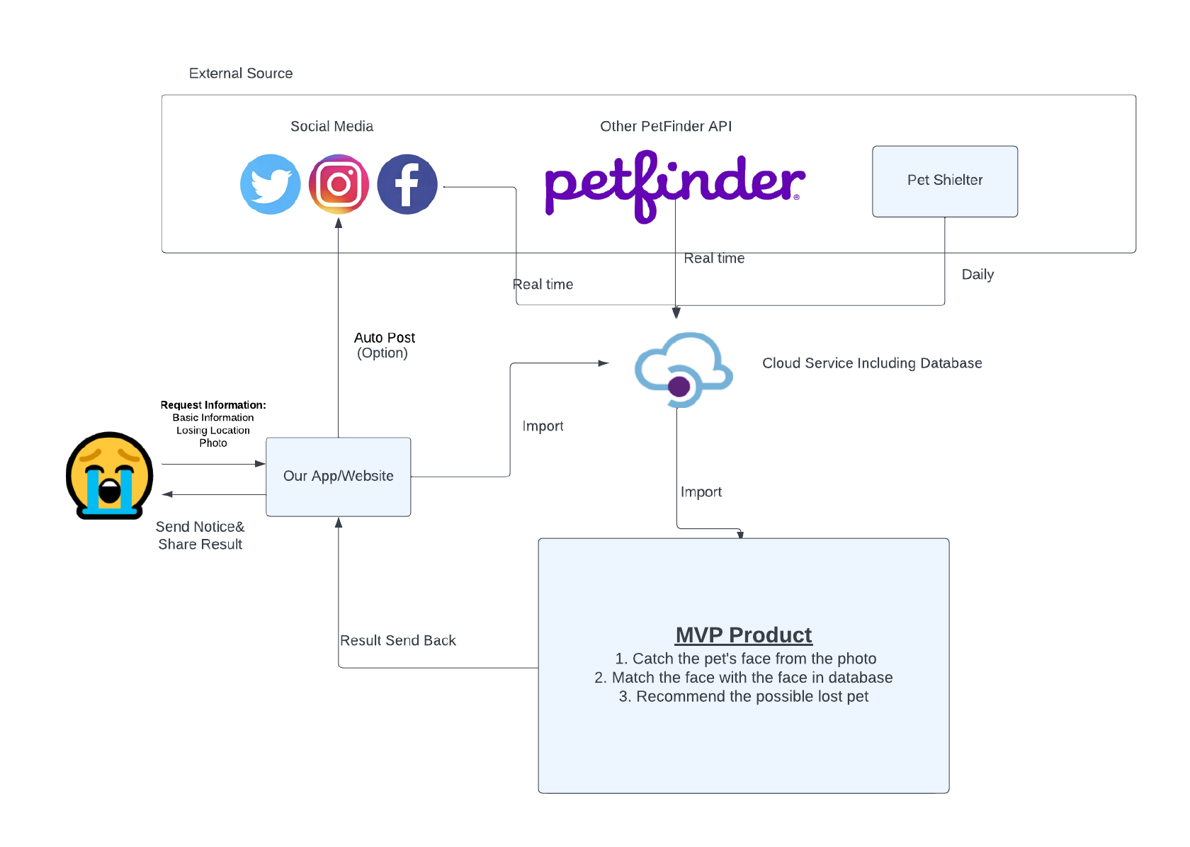
3. Final Product

Slide 8
4.Something you should think about
What did Product owner/team do?
How did those design&analysis influence the tech team？
What kind of stuff did product team deliver to tech team?

Slide 9
2. Product Design
Background & Design & Analysis

Slide 10
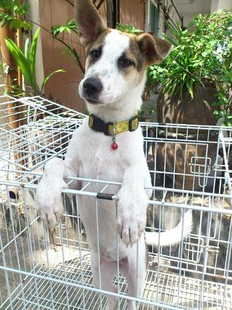
Background Introduction
There are approximately 76.8 million dogs and 58.4 million cats living as companion animals in households in the United States alone.
4 existing pet finding methods:
Contact local animal shelters and animal control agencies
Search the neighborhood
Advertising
Try the internet
Growth in Computer Vision technology
A lot of models which are trained by the pet pictures and can be used.
Feasible&Valuable！
Notes:
可行性

Slide 11
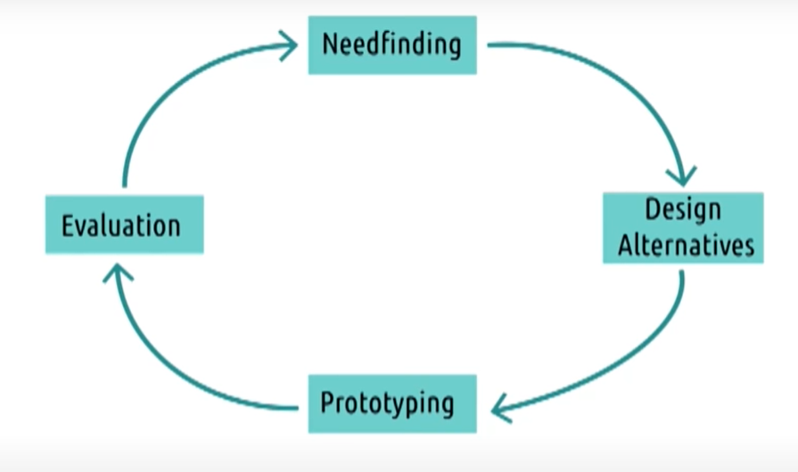
2.The Design Lifecycle

Slide 12
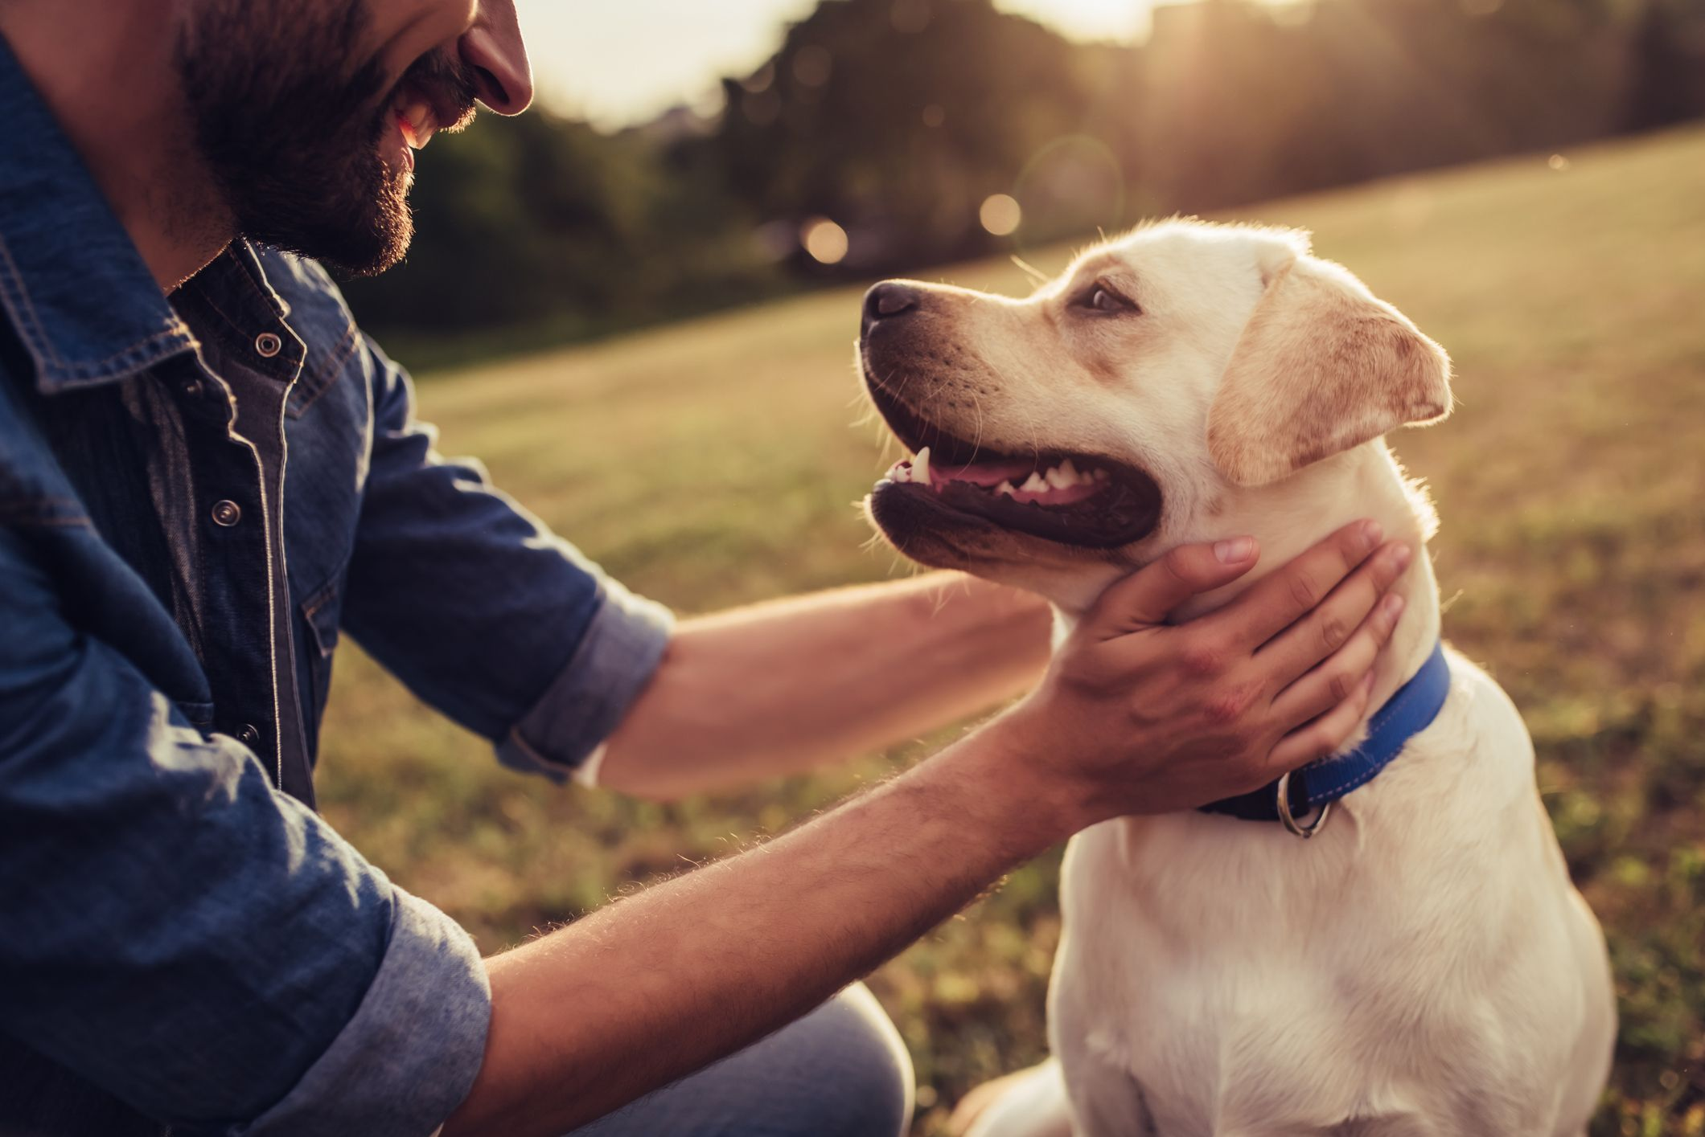
2. Product Design Process: Needs Finding
Needs Finding:
Action we did:
Discussion
Participant Observation (Team member)
User Interview (7 interviews recorded)
Learn About Your User!
Problem Space: Pet Losing
User Type: Pet Owners
Defining Requirement:
The Current method(Social Media, Paper posting, Neighbor etc.) can not meet the pet owner’s demand.
A more efficient way to find out the pet.
A way to recognize other’s information which is relevant to their pet.
More people to help them finding the pet.
Notes:
Discussion:define goal and users

Slide 13
2. Product Design Process: Design Alternative
Idea:
Auto Information posting and information extraction
Extract the pet face from the photo
Validate the pet face to the user’s pet
Action we did:
Individual Brainstorming
Group Brainstorming
Brainstorm potential solutions!
Lose Pet
Lose Pet
User Modeling
Ask Neighbors
Post in paper or social media
Ask Neighbors
Post in paper or social media
Current Process
Wait until someone contact pet owner
Wait until someone contact pet owner
Product Effect
Recognize the information
Recognize the information
Find the pet
Find the pet
Notes:
自动发布 自动识别

Slide 14
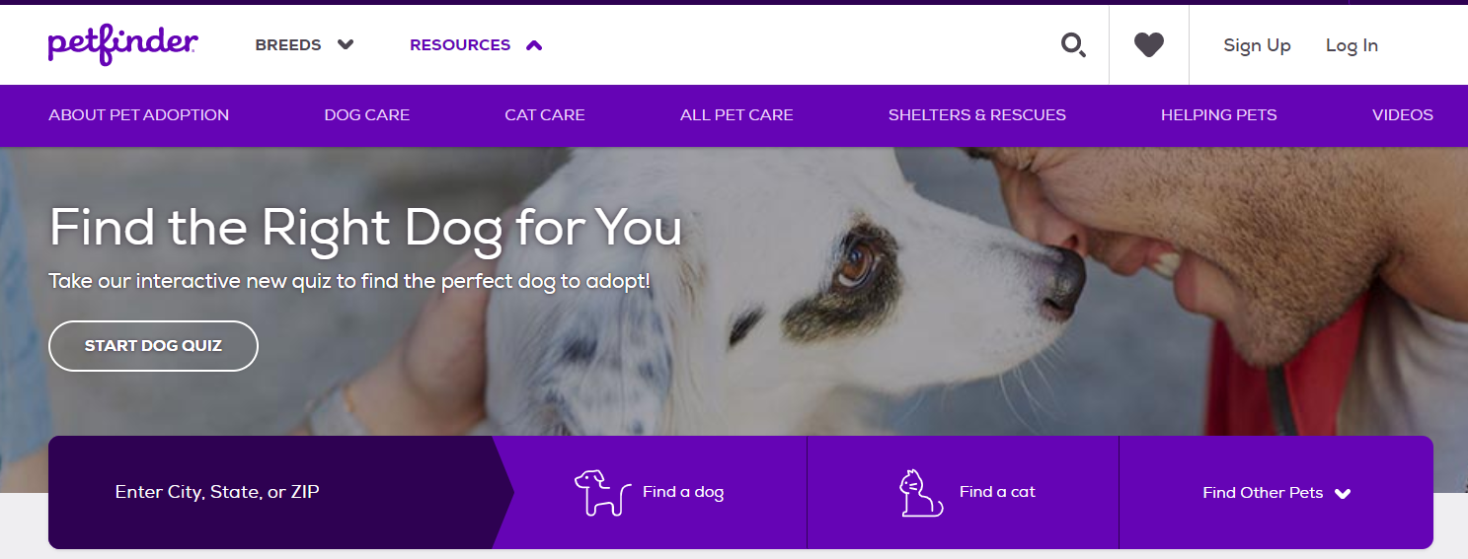
3. Prototyping
Business Goal：Help pet losers to find pet more effectively and efficiently

Slide 15
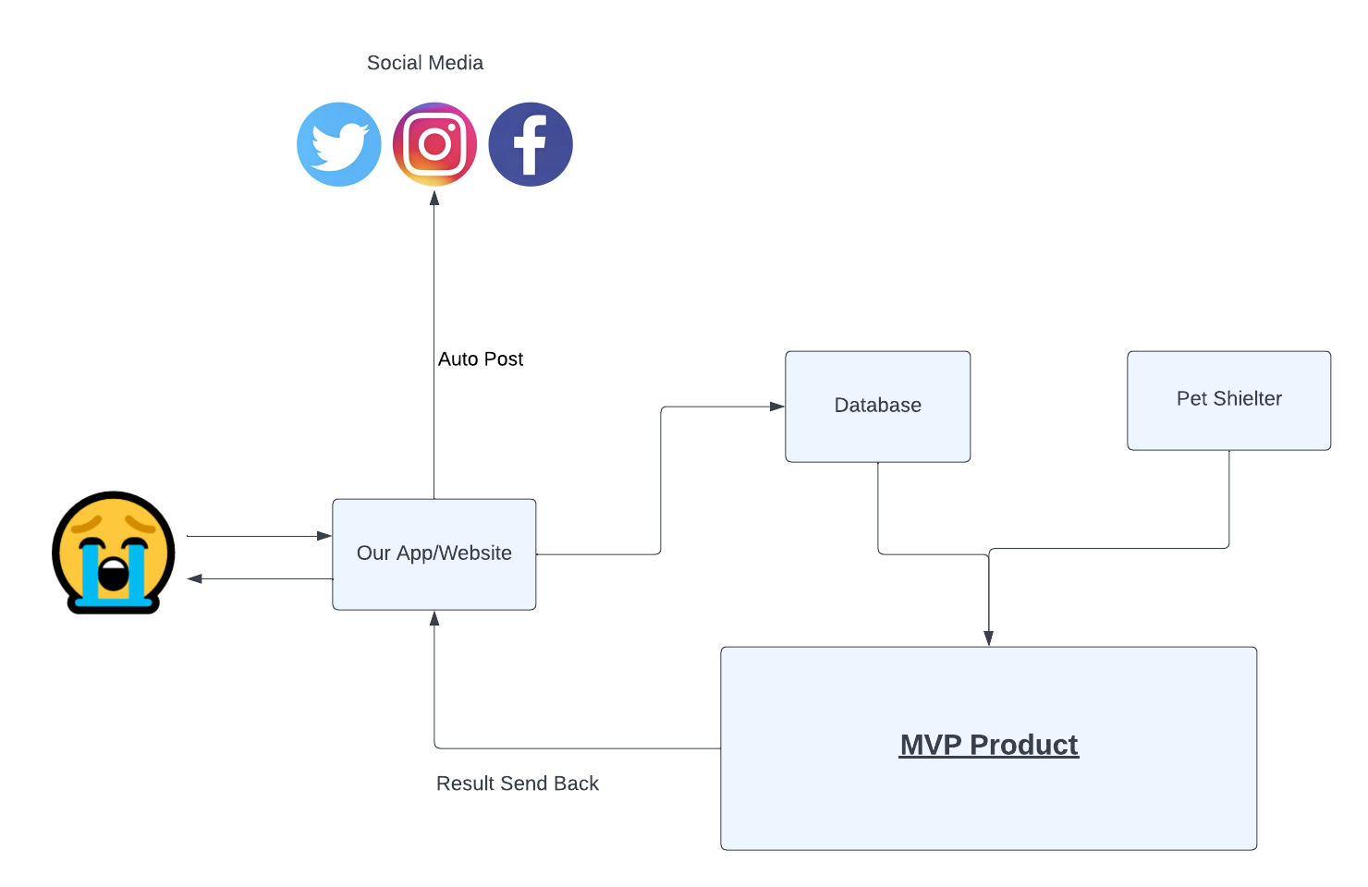
3. Product Design V1.0
Start with a lo-fi prototype

Slide 16
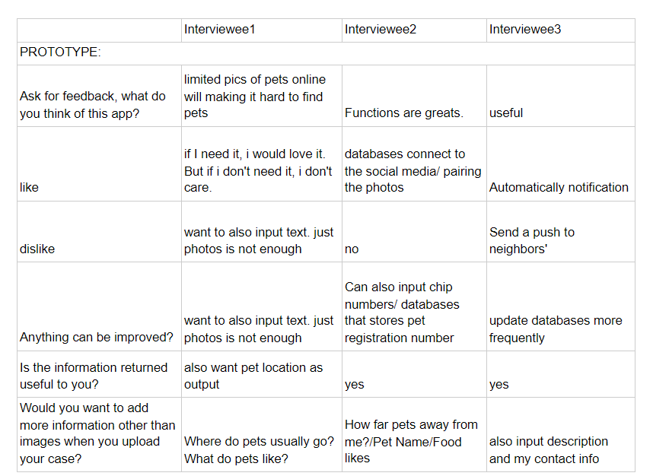
4. Product Design Process: Evaluation
Get that prototype in the hands of some real users.
Some thinking:
1.Pets photo limitation
2.Option Design
3.Photo resource limitation
4.Customer Feeling in Output

Slide 17
5. Final Product

Slide 18
3. Business Analysis
Quick Glance
Notes:
这块会非常快的一笔带过

Slide 19
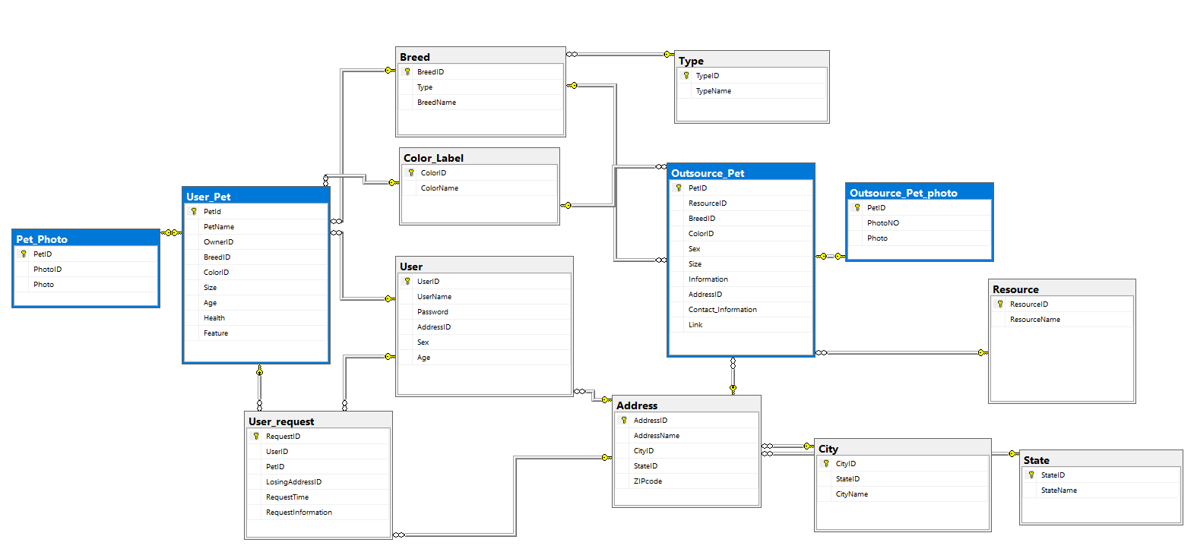
Database Design
Model Input
Notes:
明确了哪些数据我们可以辅助应用，哪些数据我们是需要采集用来帮助模型架构的

Slide 20


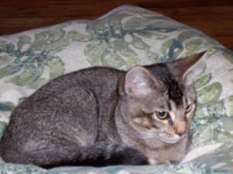
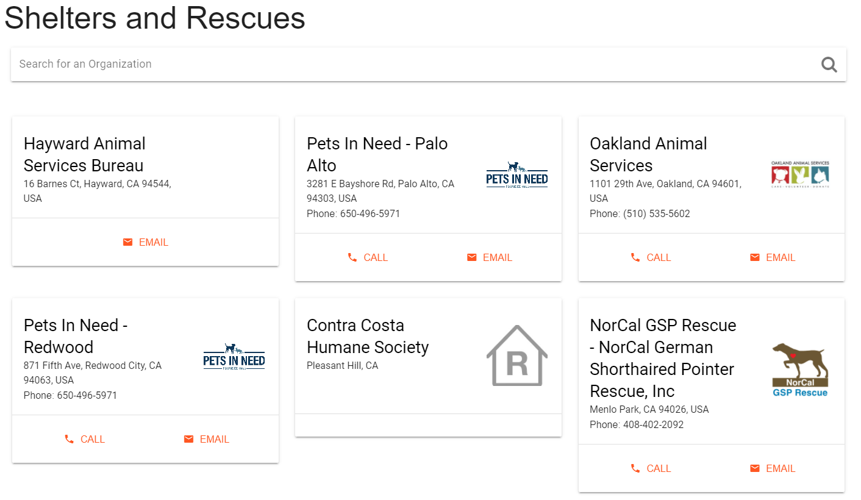
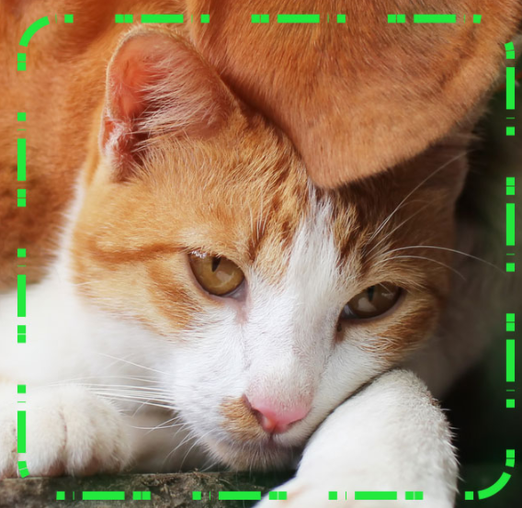
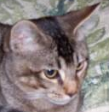




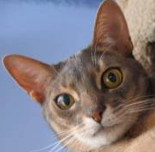
2. Product Comparison
+
+
+
+
Notes:
明确了，一定要抓脸，而不是让宠物主人找相关照片

Slide 21
3. SWOT Analysis
Strength:
Less limitation in pet photos
More outside resources
Easier use for customers
Weakness:
Less current data
New to the market
Unknown to the pet owners
Opportunity:
More pet owners
Powerful CV technology
Social media for pet finding
Threats:
Competitor‘s product is mutual
Other strong potential competitors

Slide 22
3. SWOT Analysis
Strength
Weakness
SO:
Use our strength to help more customers
Let customers to promote our product
WO:
Using the latest model
Attract the young pet owners
Opportunity
Threats
ST:
Try to let customers know our product is more efficient and effective
Let our competitor see our product’s potential.
WT:
If fail, sell our product to petfinder
If investment is enough, add competitors’ function to our app and use more marketing investment to win the market

Slide 23
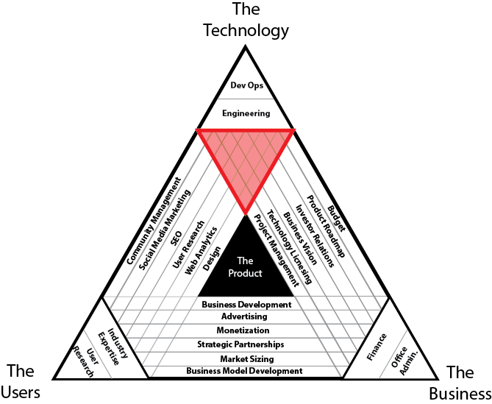
4.Product Building Plan
Keep improving our product design by getting feedback from our potential customers
Build the function which can automatedly link our database to outside resources
Build the function which can automatedly post our customers’ requests
Design the UI for our App
Design the Website
Lifetime Model retrain
Running out of time test

Slide 24

4.Business Plan
Contact the pet shelter and rescues
Contact the petfinder.com to ask for data and co-op
Build relationship with pet blogger(or vlogger) and pet youtubers
Increase influence in pet BBS and pet groups in social media
Check the law and regulation relative to the pet

Slide 25
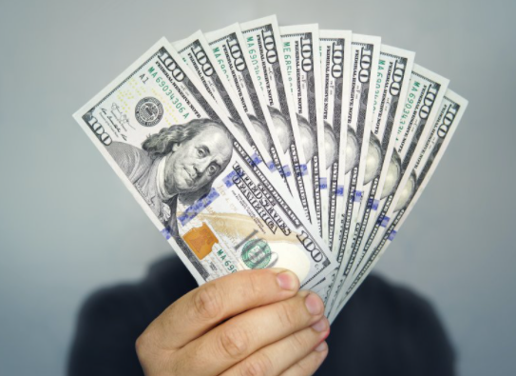
4.Business Plan : Profit Planning
ADs for pet-relative company like pet food company
Build extra functions like sell pet relative courses and earn the membership fee
Plan to make profit after 1 year operation

Slide 26
5. Summary

Slide 27
Tech Part

Slide 28
2. Product Building
Technical Highlights

Slide 29
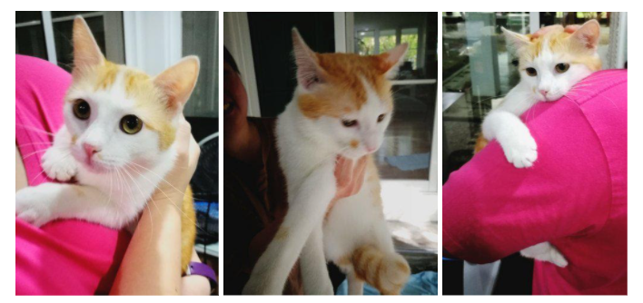
Data Introduction
Resource: Petfinder.com
Pet: 18967
Photo: 72776
Size: Over 2.3 G
Pet Type: Cat & Dog

Slide 30
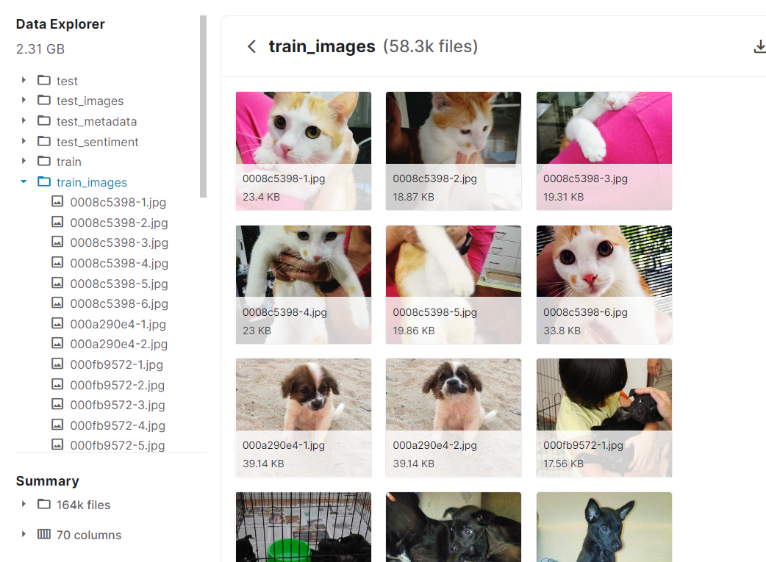
Data Introduction

Slide 31
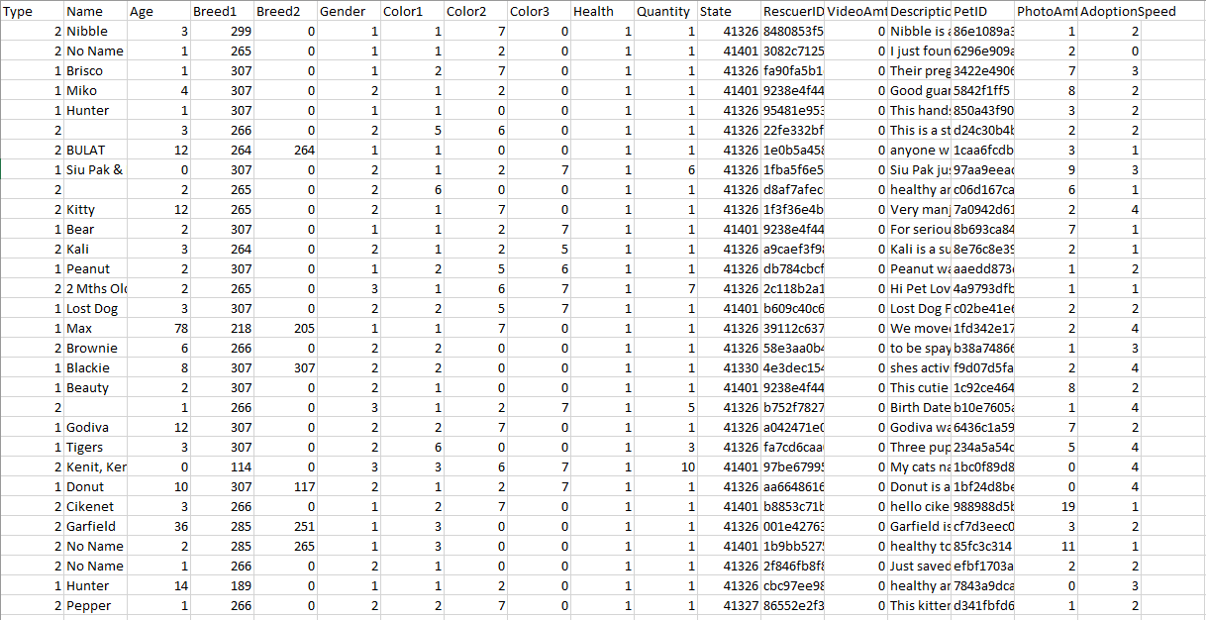
Data Introduction

Slide 32
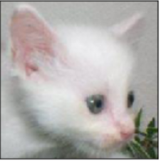

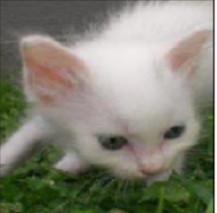
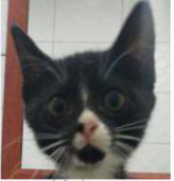
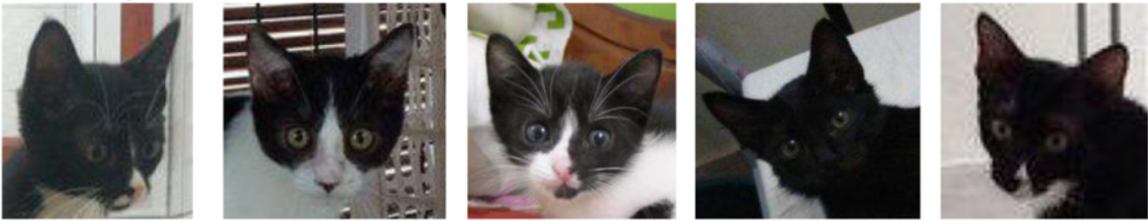

Approach
Face Verification: Validating a claimed identify based on the image of face. One-to-one matching
Face Recognition: Identify a pet based on image of a face. This face has to be compared with all the registered persons. One-to-many matching
Query Image Images in Database
Same?
Which images match?

Slide 33
2.2 Architecture of Models
Architecture
Face Verification
Face Recognition
Model Training / Prediction
Evaluation & Demos
Model Training / Prediction
Evaluation & Demos

Slide 34
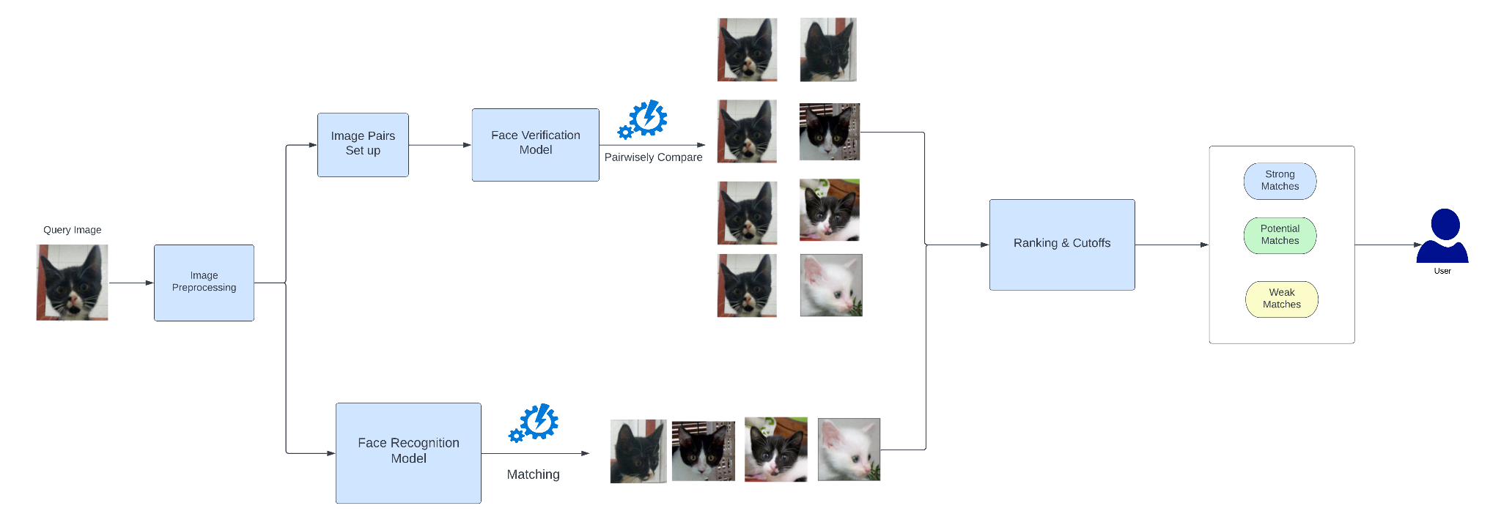
Roadmap Overview

Slide 35
4. Face Verification

Slide 36
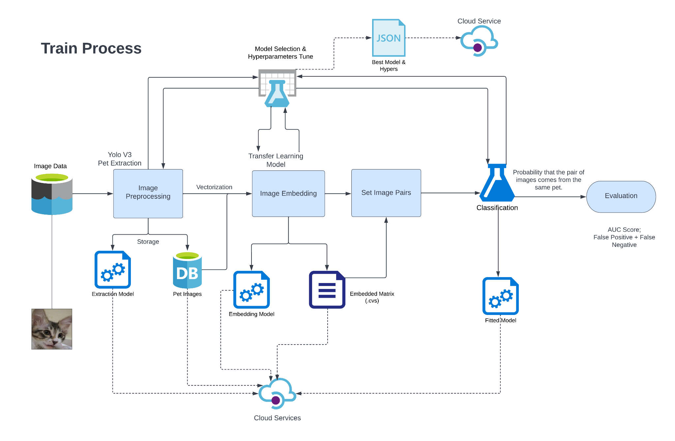

Slide 37
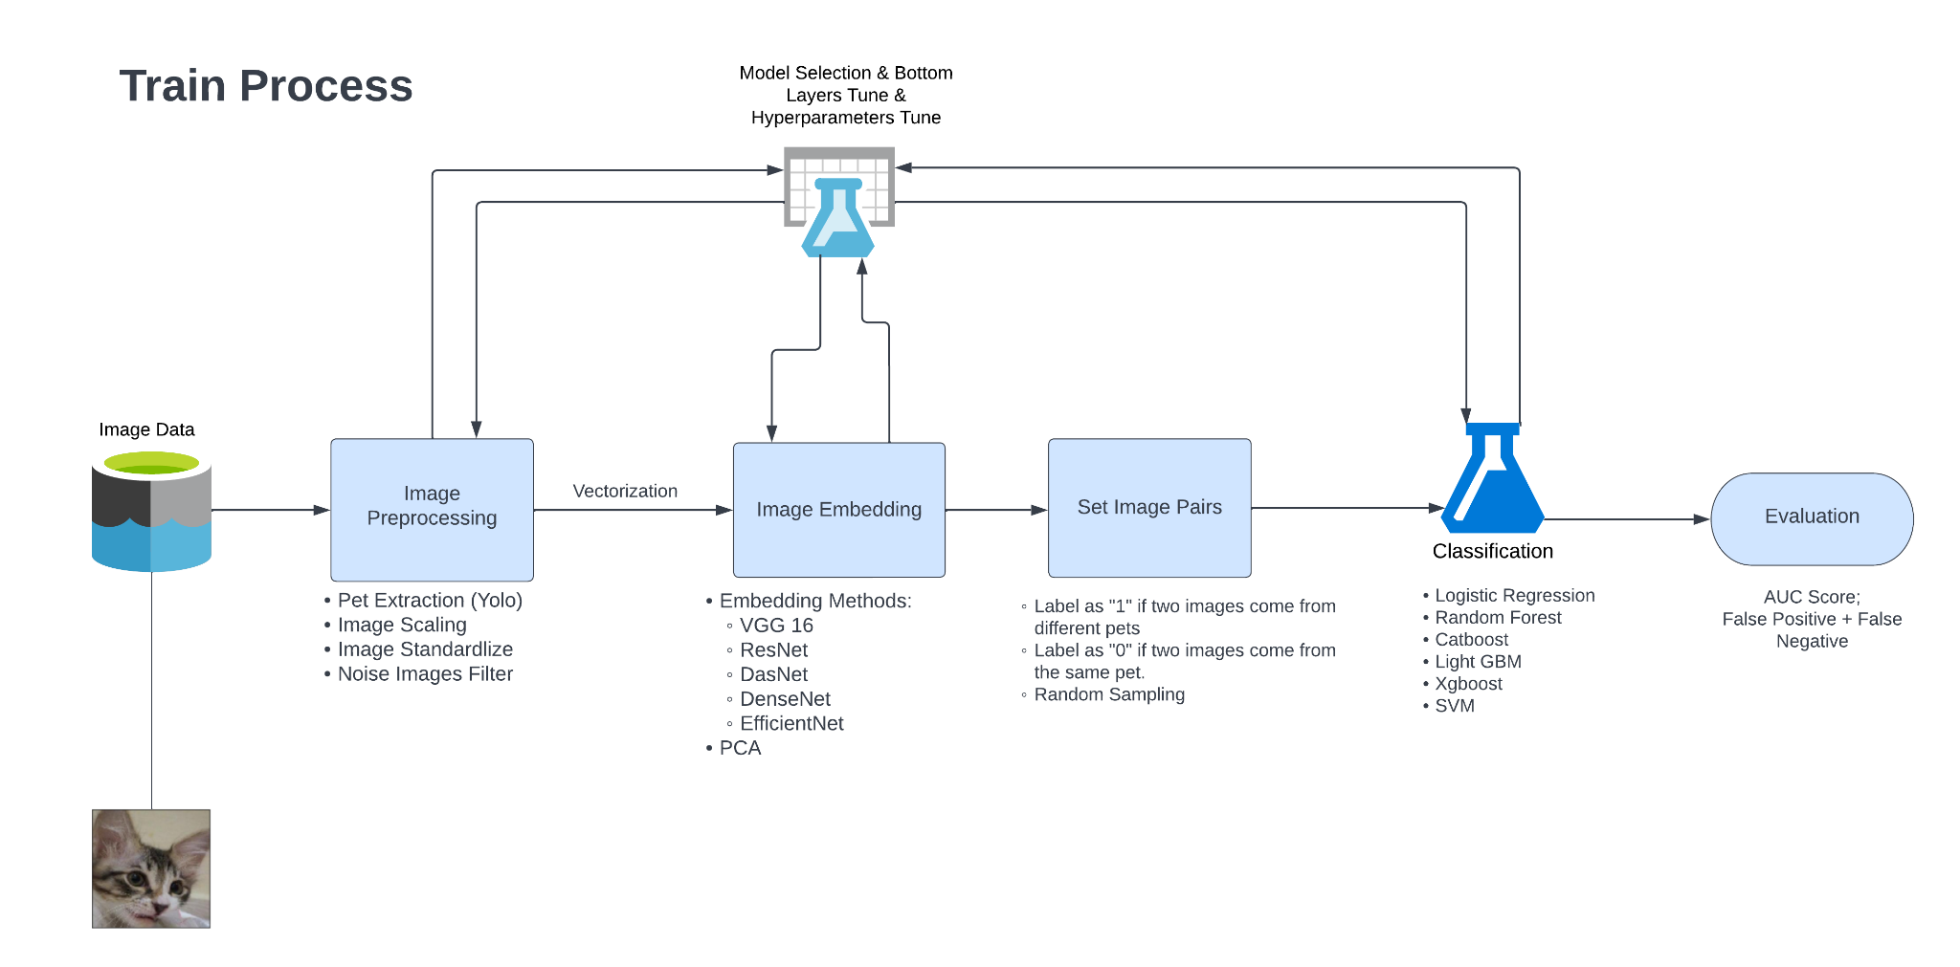

Slide 38
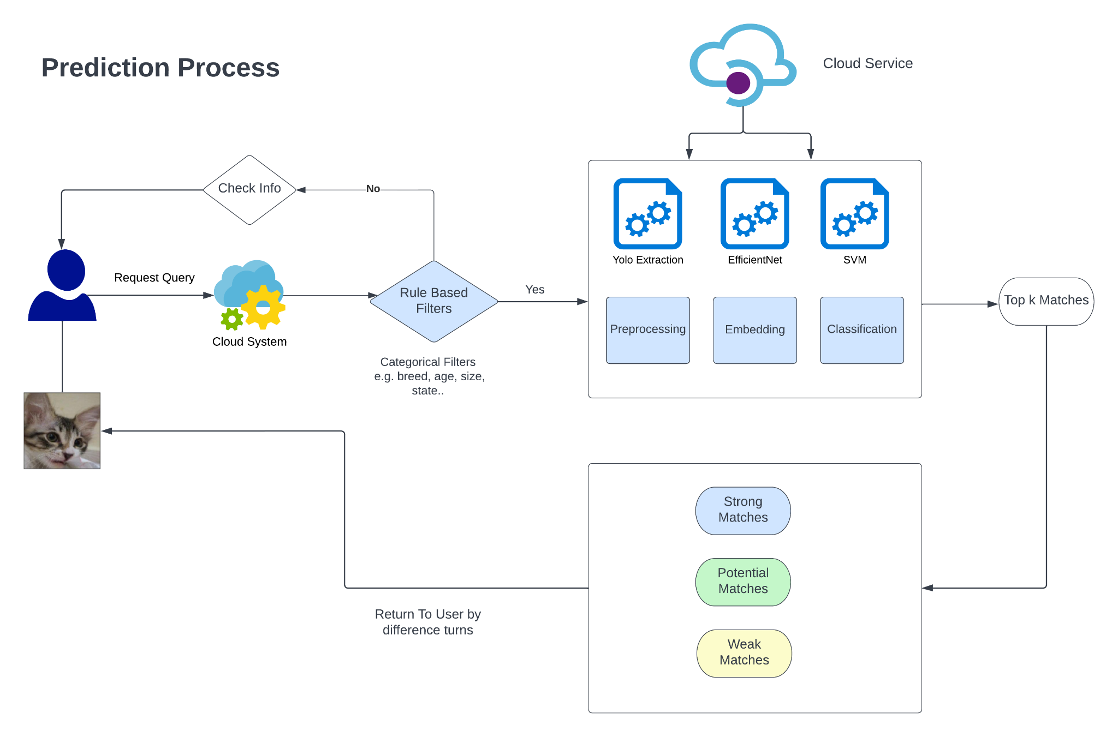

Slide 39
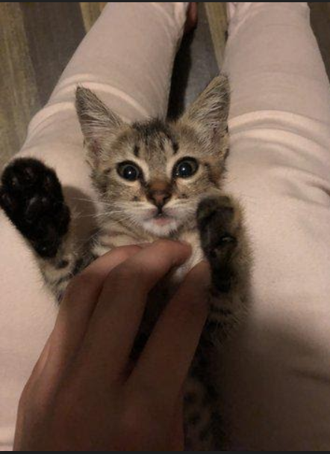
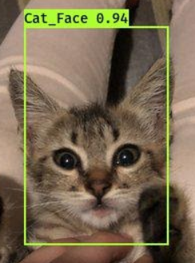
Face Extraction
For better performance in face verification, we need to extract the face part from our images to reduce noise.

Slide 40
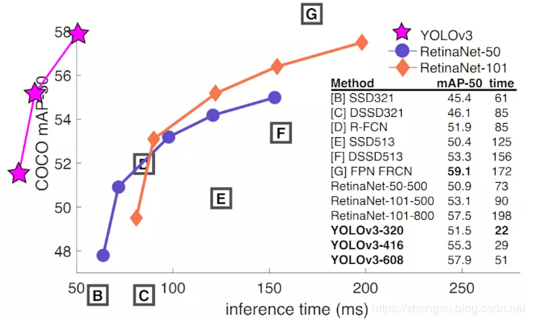
Object Detection - YOLOv3
Introduced by Joseph in April 2018, the most popular and stable version of YOLO (You Only Look Once).
Decent accuracy, but with really short processing time, which is important to our product.

Slide 41
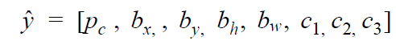
Object Detection
Classification with Localization :
Feed the model with the location of box in training data
P_{c} : whether there is an object in the box cell
[b_{x}, b_{y}, b_{h}, b_{w}] : location of the box cell (the location of centroid, height, width).
[c1, c2, c3…..]: the class of the object

Slide 42

Evaluation
Intersection over Union (IoU)

Slide 43
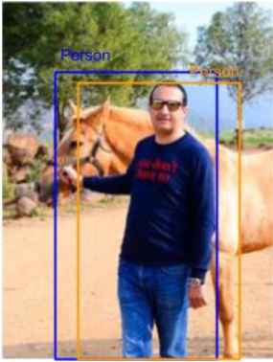
Demo
Yolo V3:
Extract All Images that IoU > 0.5
Ground Truth: Blue, Predicted: Yellow

Slide 44
Extracted Face
Image Embedding
Sample Image Pairs
Classification
😭
😀
Face Verification Model
Evaluation & Diagnose

Slide 45
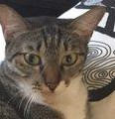
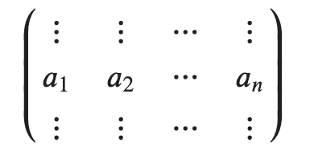
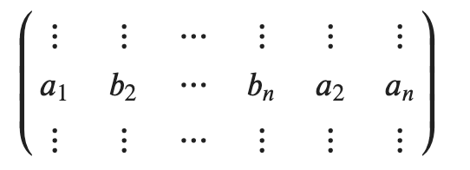
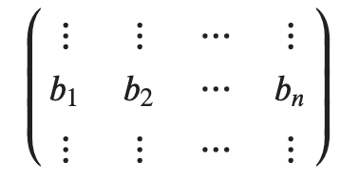
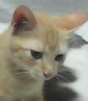
Embedding & Pair
Embedding
Append & Shuffle
Image ID: 9d466bbca-6
Embedding
Label
1
Image ID: 4b148edd2-7

Slide 46
Embedding Models
VGG
ResNet
NasNet
DenseNet
Efficient Net
PCA (90% Variation)

Slide 47
Classification Methods
Logistic Regression
Random Forest
xgBoost
SVM
Light GBM
Cat Boost

Slide 48
Classification Result (Validation)
By AUC Score
 | VGG 16 | ResNet | NasNet | DenseNet | EfficientNet
Logistic Regression | 0.539 | 0.523 | 0.508 | 0.597 | 0.492
Random Forest | 0.769 | 0.810 | 0.816 | 0.801 | 0.859
XG Boost | 0.693 | 0.749 | 0.809 | 0.737 | 0.756
Light GBM | 0.701 | 0.776 | 0.851 | 0.749 | 0.801
Cat Boost | 0.723 | 0.781 | 0.797 | 0.813 | 0.824
SVM (Gaussian Kernel) | 0.863 | 0.842 | 0.861 | 0.809 | 0.902

Slide 49
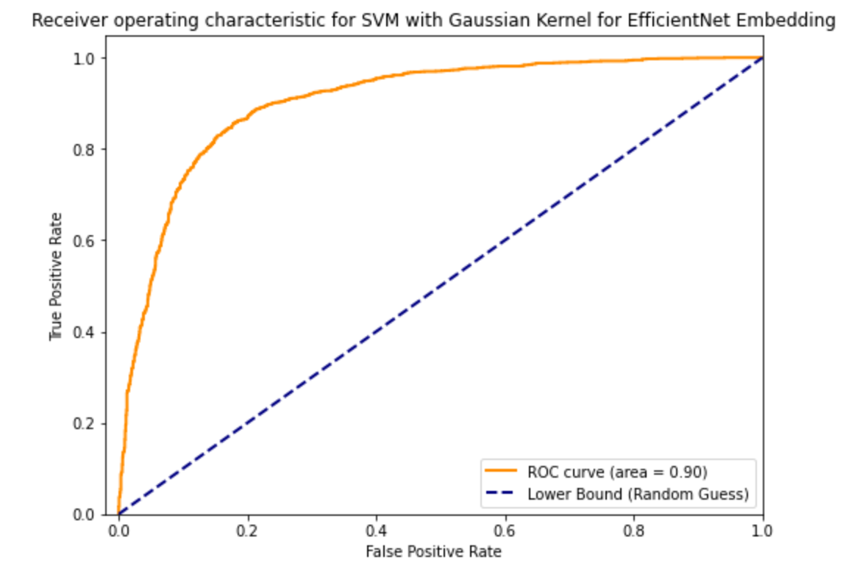
Classification Performance Evaluation

Slide 50
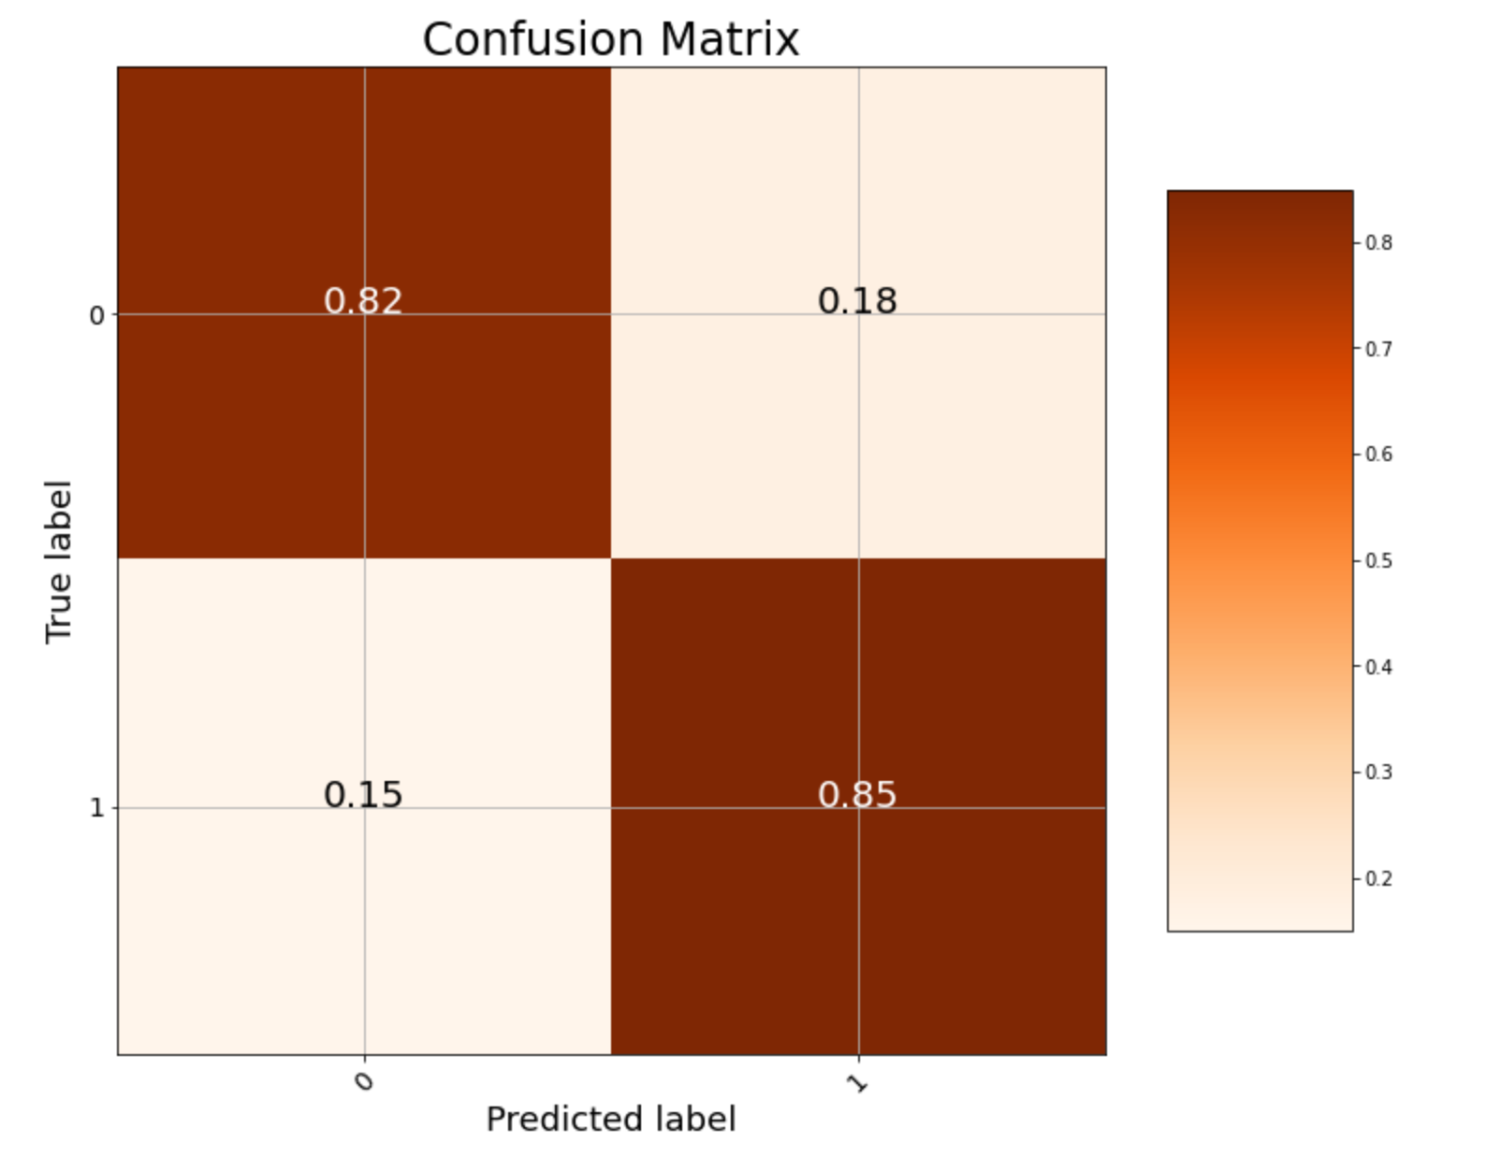
Classification Performance Evaluation

Slide 51
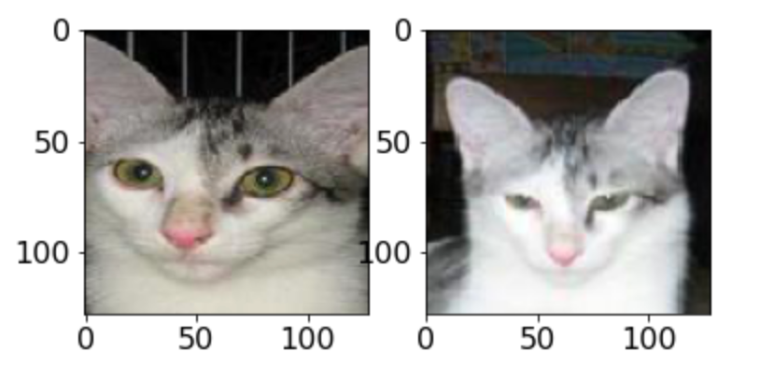
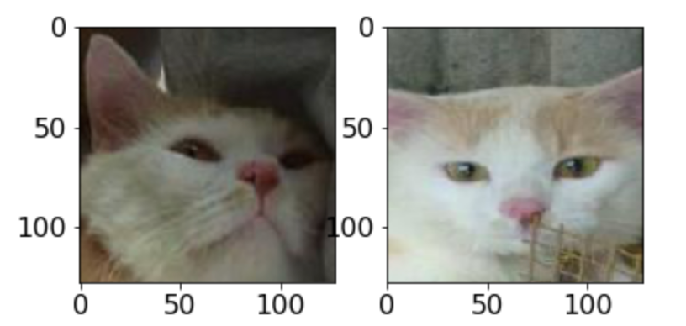
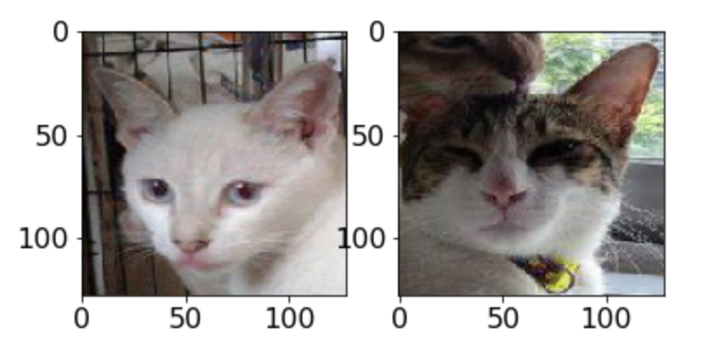
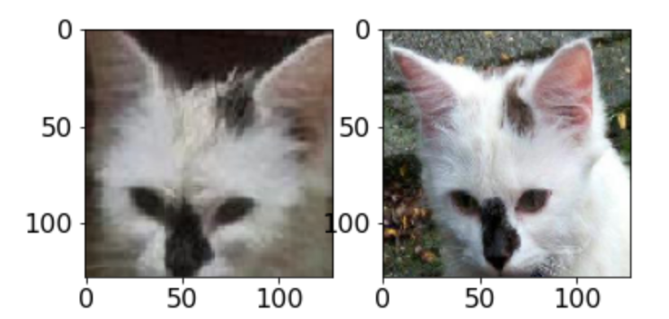
Some Demos
Predicted: same, Actual: same
Probability: 0.970
Predicted: same, Actual: same
Probability: 0.854
Predicted: same, Actual: same
Probability: 0.930
Predicted: different, Actual: different
Probability: 0.942

Slide 52
5. Face Recognition

Slide 53
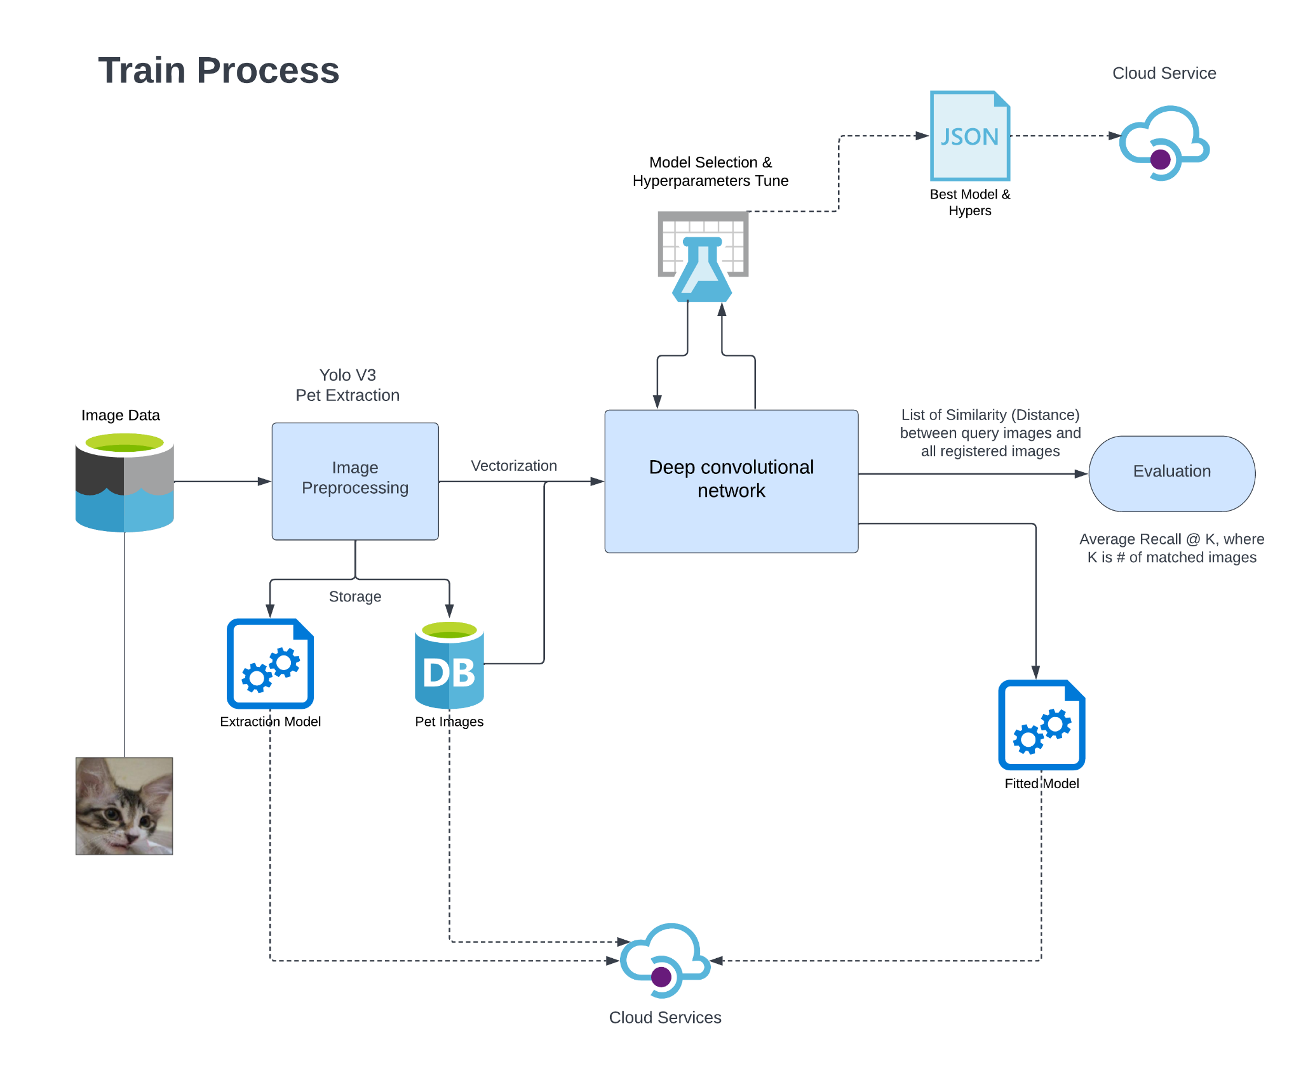

Slide 54
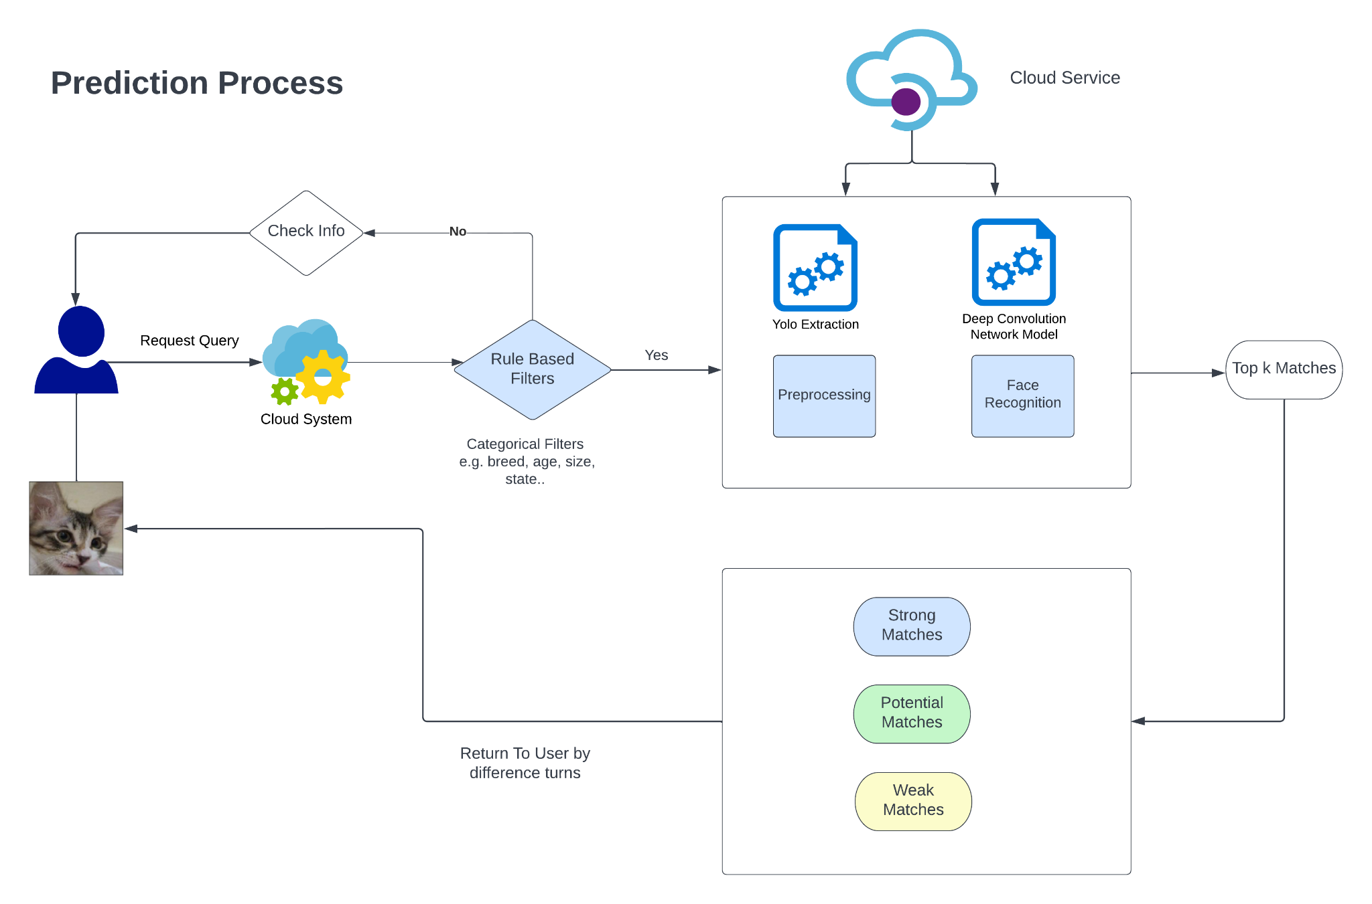

Slide 55
6.2 Evaluation Metrics
The metrics should reflect real user experience
Any photo shows the target pet
success
Users upload a photo
Model returns k numbers of photos
No photo shows the target pet
failure
Recall@k: The average success rate for k returned photos

Slide 56
Face Recognition Models
Triplet Loss Model
Proxy NCA
Contrastive Model
MS
Proxy Anchor Loss Model

Slide 57
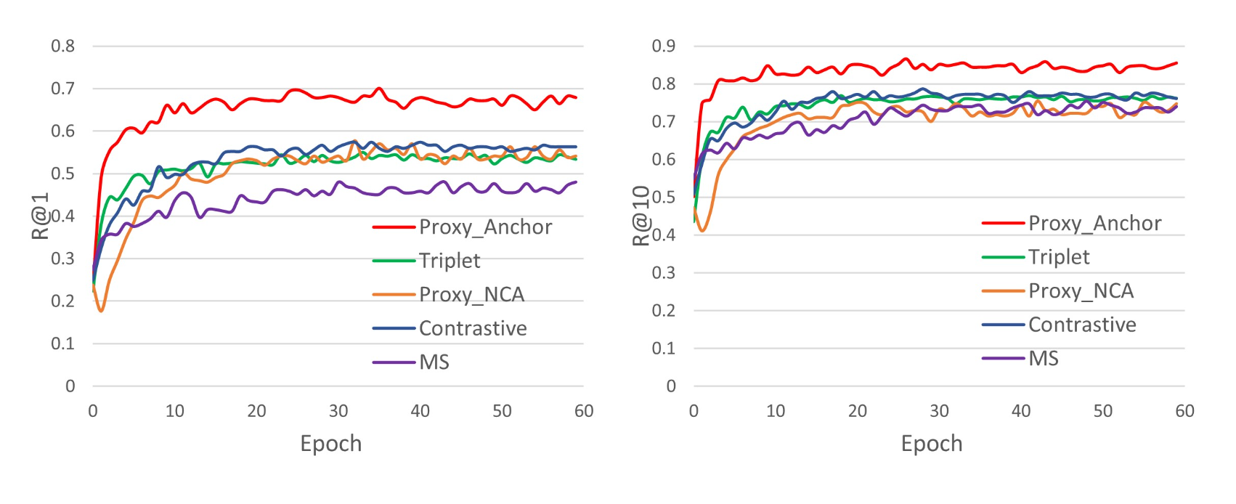
Model Performance Evaluation
Proxy Anchor Loss Model:
Recall @ 40: 0.954

Slide 58
5.1. CNN Approach: Triplet Loss

Slide 59
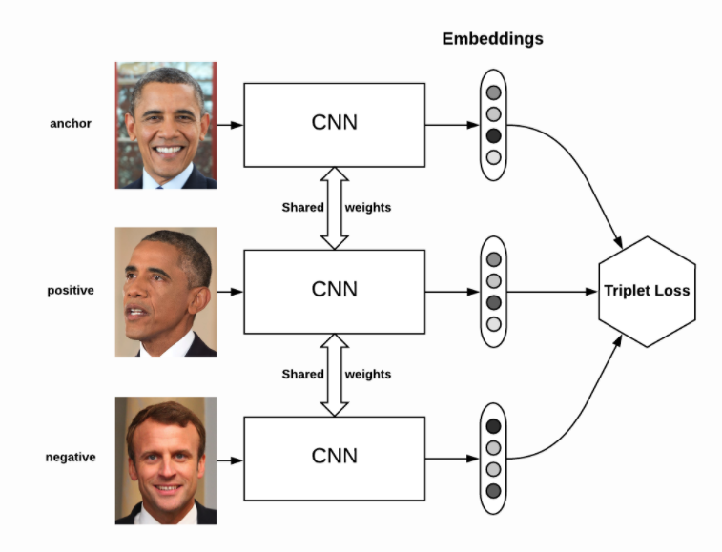

What is Triplet Loss?
d: Euclidean Distance
Loss Function:
d(a,p)
Goal: Minimizes the distance between an anchor and a positive; maximizes the distance between the anchor and a negative.
d(a,n)

Slide 60
5.2 CNN Approach: Proxy Anchor Loss

Slide 61


6.1 Loss function: Proxy anchor loss
Proxy for Pet 1
In-class distance from
points to Proxy (IDPP)
Pet 1
Pet 2
Between-class distance from
points to Proxy (BDPP)
Pet 3
Sum of IDPP
Loss for each proxy
Sum of BDPP

Slide 62

4. Result

Slide 63

4. Result

Slide 64

4. Result

Slide 65
7. User Experience Enhancement

Slide 66
Goal:
The most important measurement:
Find true pet (Recall @ Matches)
Precision Not Important?
Waste user concentration
How to enhance Precision?
What if no true matches in database?
Possible Solution: What about Return image by multiple turns?

Slide 67


Return Image Process
All matched Images
Strong matches
Weak Matches
Potential Matches
Return potential matches
Face Verification Model
Only return strong matches to users
Not Find
Not Find
Visit
Ask More Information
Find
E.g. More pet images

Slide 68

Output Scores

Slide 69

Determine Cutoff (Threshold)
Treat as a hyperparameter: (Fixed)
Draw Elbow Curve to tune the best number
Problem: high performance variance Pet face characteristics
Some of pets are easy to find by nature; but some of the pets are hard to find, so need more images return
Treat as a variable (Dynamic)
Hypothesis test approach
Cluster approach

Slide 70
Performance
 | Fix Return Approach (Strong: 35 images Potential: 32 images) | Dynamic Approach
Average Recall @ Strong Matches | 0.914 | 0.952
Average Recall @ Potential Matches + Strong Matches | 0.974 | 0.971

Slide 71
Face Verification v.s. Recognition
 | Face Verification | Face Recognition
Average Recall @ Strong Matches | 0.940 | 0.952
Average Recall @ Potential Matches + Strong Matches | 0.964 | 0.971
Prediction time spend | A little Bit Slow | Fast
# replied models | 3 | 2
Offline Model Performance between face recognition and verification is similar. (although face recognition looks a little bit)
Computational advantage might be diluted by rule based categorical filters.
(*) Apply face verification for back-up “review”.

Slide 72
Final Summary
Pet Finding Model
Face Verification
One-to-one
Face Recognition
one-to-many
Efficient Net + PCA + SVM
Proxy Anchor Loss

Slide 73

Thanks!
Any questions?

Slide 74
Useful Link:
Github: https://github.com/DS-XL/Pet-Face-Deep-Recognition
Medium:
Business: https://medium.com/pet-face-deep-recognition/product-design-process-c51442f53257
Tech:
https://medium.com/@hbdkfklc/algorithm-design-fa2156e983c6

Slide 75
References
https://towardsdatascience.com/breaking-down-mean-average-precision-map-ae462f623a52
https://jonathan-hui.medium.com/map-mean-average-precision-for-object-detection-45c121a31173
https://cocodataset.org/#detection-eval
https://blog.csdn.net/catscanner/article/details/104097467
https://mropengate.blogspot.com/2018/06/yolo-yolov3.html
https://darren1231.pixnet.net/blog/post/349397434-object-detection%E7%9A%84%E7%94%B1%E4%BE%86
https://medium.com/cubo-ai/%E7%89%A9%E9%AB%94%E5%81%B5%E6%B8%AC-object-detection-740096ec4540

